Slide 1
Kao metrics confusion

Slide 2
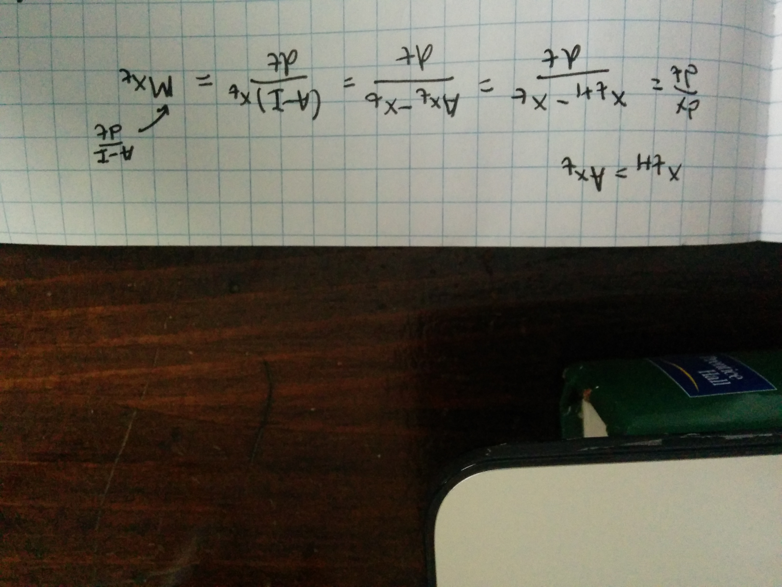
They define M = (A-I) / dt:

Slide 3
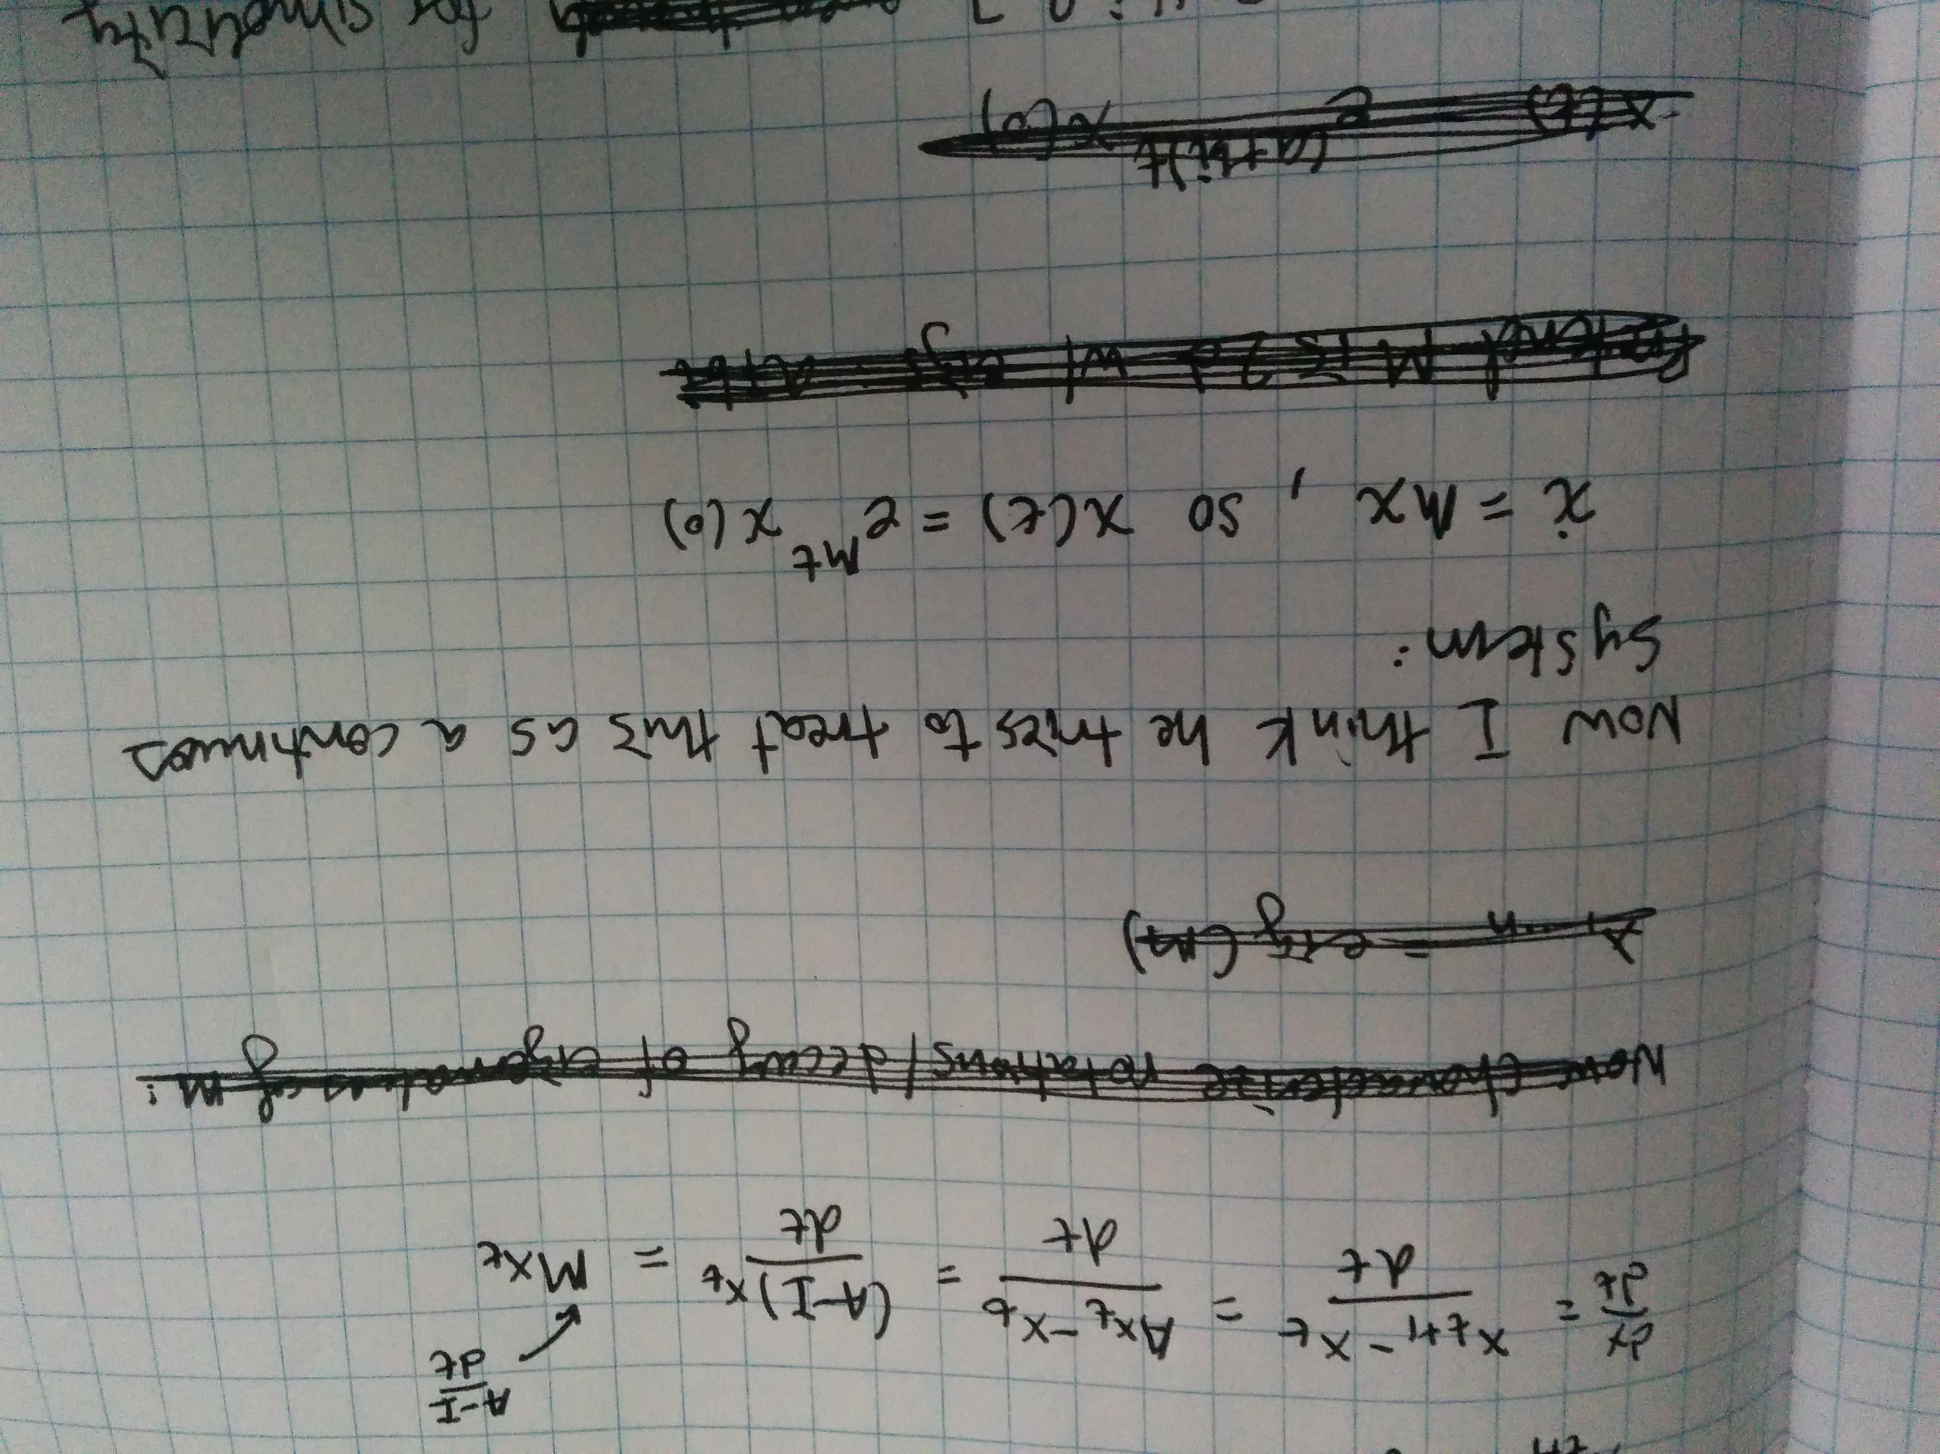
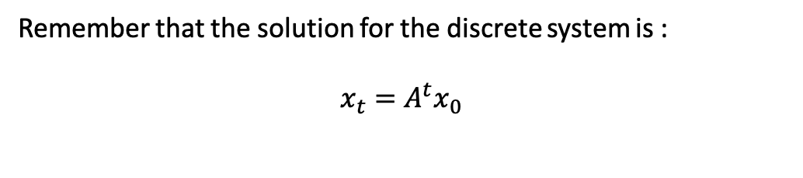
Treated now as a continuous system:
Remember that the solution for the discrete system is :
$$x_{t}=A^{t}x_{0}$$

Slide 4
Simplification to decay term and oscillation term

Slide 5

Decay metric is -1/Re($λ)$

Slide 6
Frequency of oscillation

Slide 7
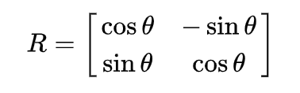
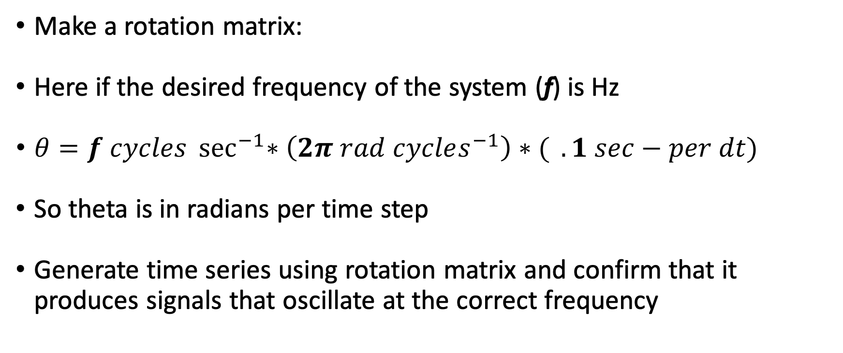
Plotting Kao metrics for 2D rotational system of different frequencies
Make a rotation matrix:
Here if the desired frequency of the system (f) is Hz
$θ=f cycles \sec^{−1}{∗\left(2π rad cycles^{−1}\right)∗( }.1 sec−per dt)$
So theta is in radians per time step
Generate time series using rotation matrix and confirm that it produces signals that oscillate at the correct frequency

Slide 8
Plotting Kao metrics for 2D rotational system of different frequencies
Create rotation matrix A
Generate data to confirm it does what I think its supposed to be doing
Then calculate Kao metrics:

Slide 9
How much do oscillations persists
(1 → fully persistence, 0 → immediate dampening)

Slide 10
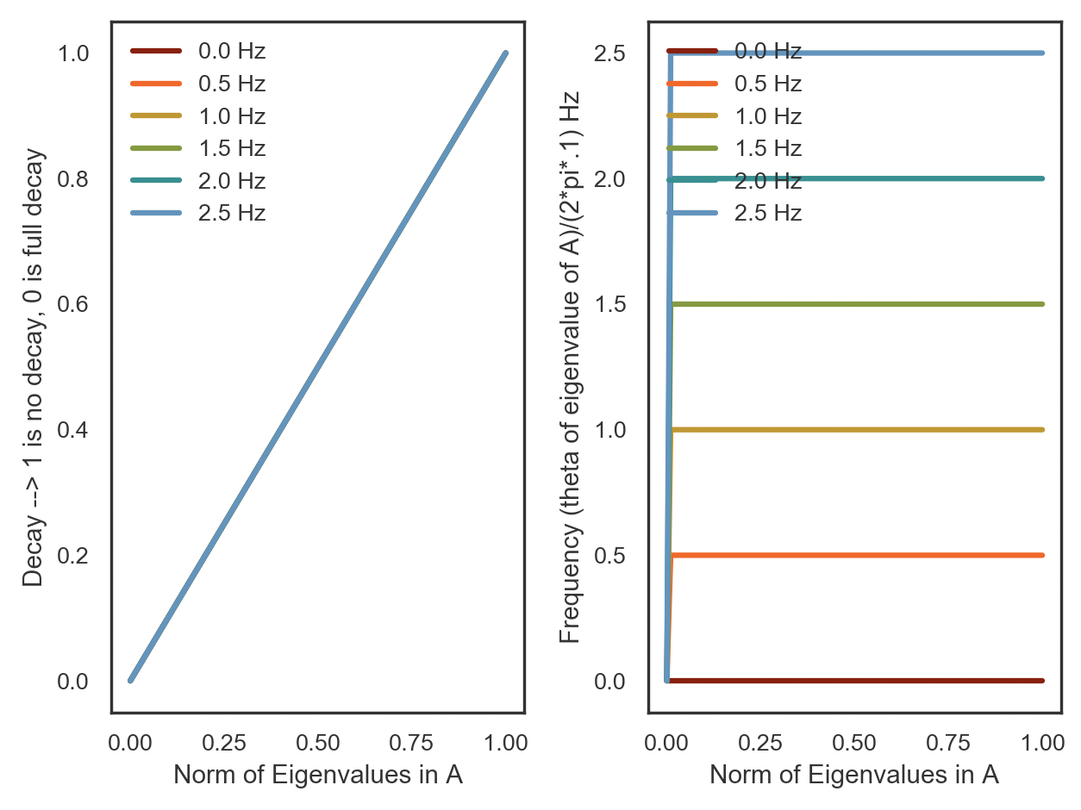
If analyze the eigenvalues of A instead

Slide 11
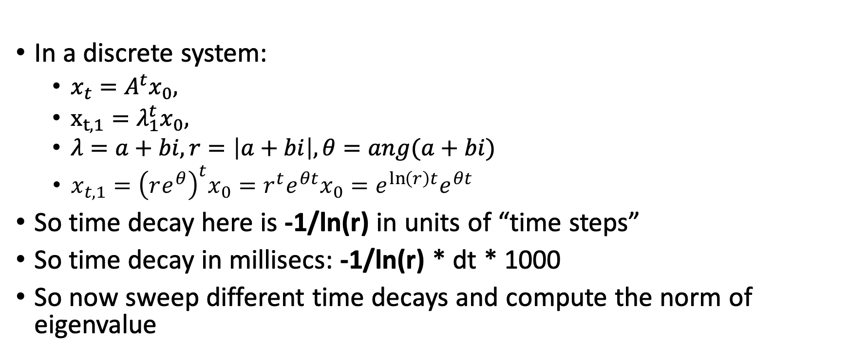
Stepping back a second – let’s make it so that the simulation parameters are i) frequency and ii) time constant of decay
In a discrete system:
$x_{t}=A^{t}x_{0},$
$x_{t, 1}=λ_{1}^{t}x_{0},$
$λ=a+bi, r=\left|a+bi\right|, θ=ang(a+bi)$
$x_{t, 1}={\left(re^{θ}\right)}^{t}x_{0}=r^{t}e^{θt}x_{0}=e^{\ln\left(r\right)t}e^{θt}$
So time decay here is -1/ln(r) in units of “time steps”
So time decay in millisecs: -1/ln(r) * dt * 1000
So now sweep different time decays and compute the norm of eigenvalue

Slide 12
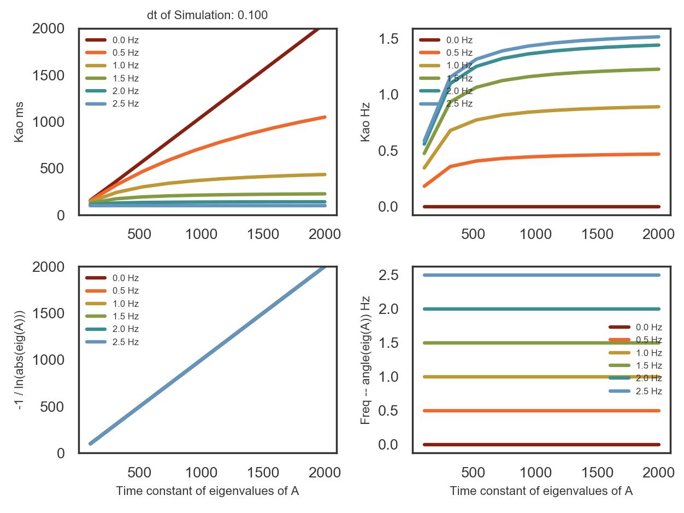
dt = 0.1 sec

Slide 13
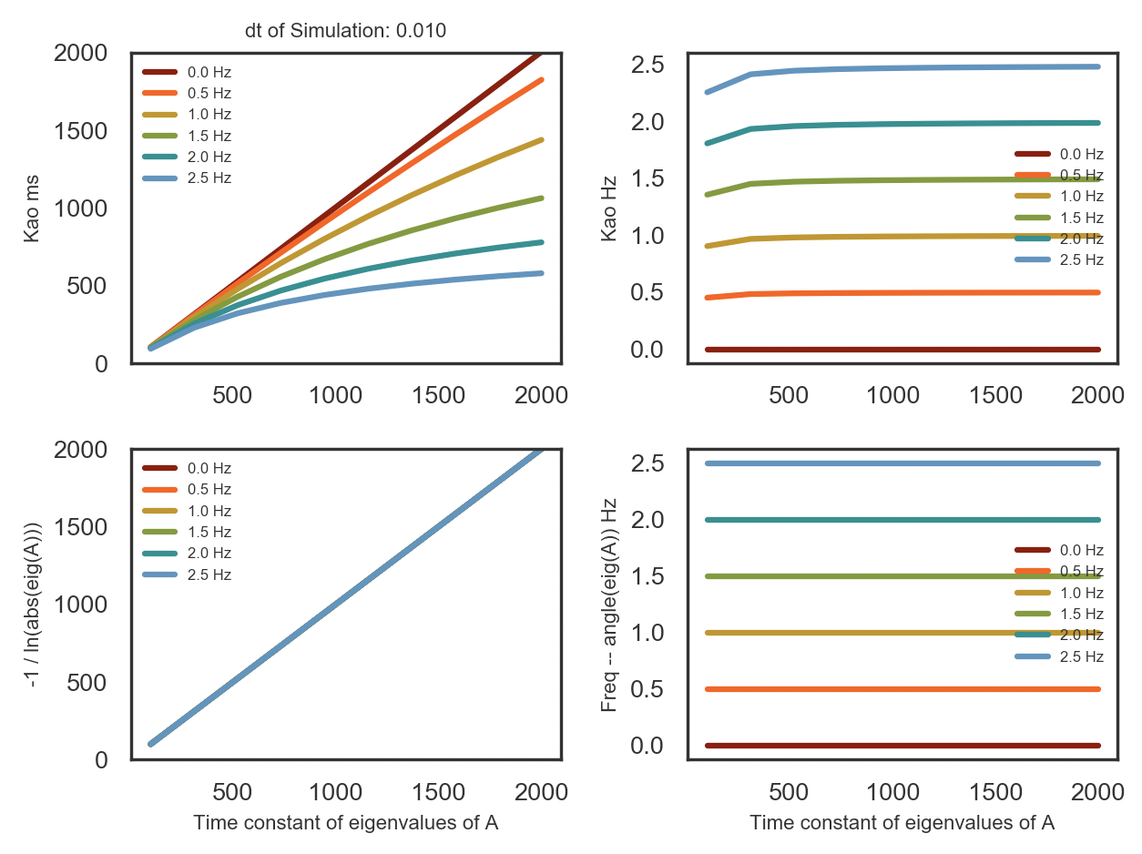
dt = 0.01

Slide 14
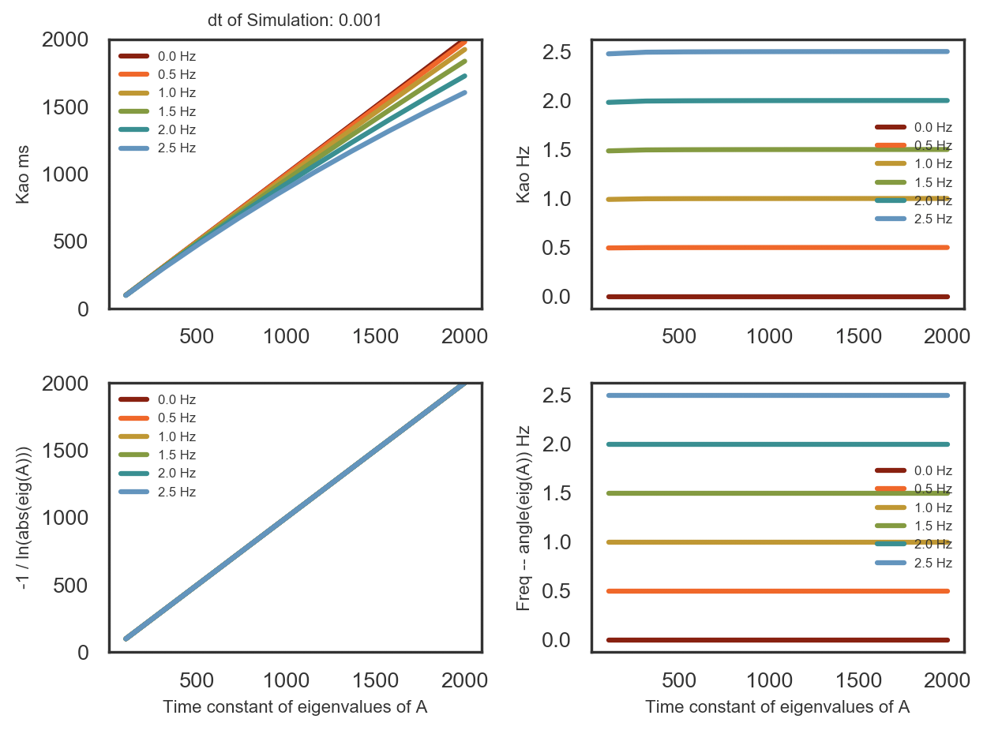
dt =0.001

